Slide 1
Close Approach to Power Lines

Slide 2
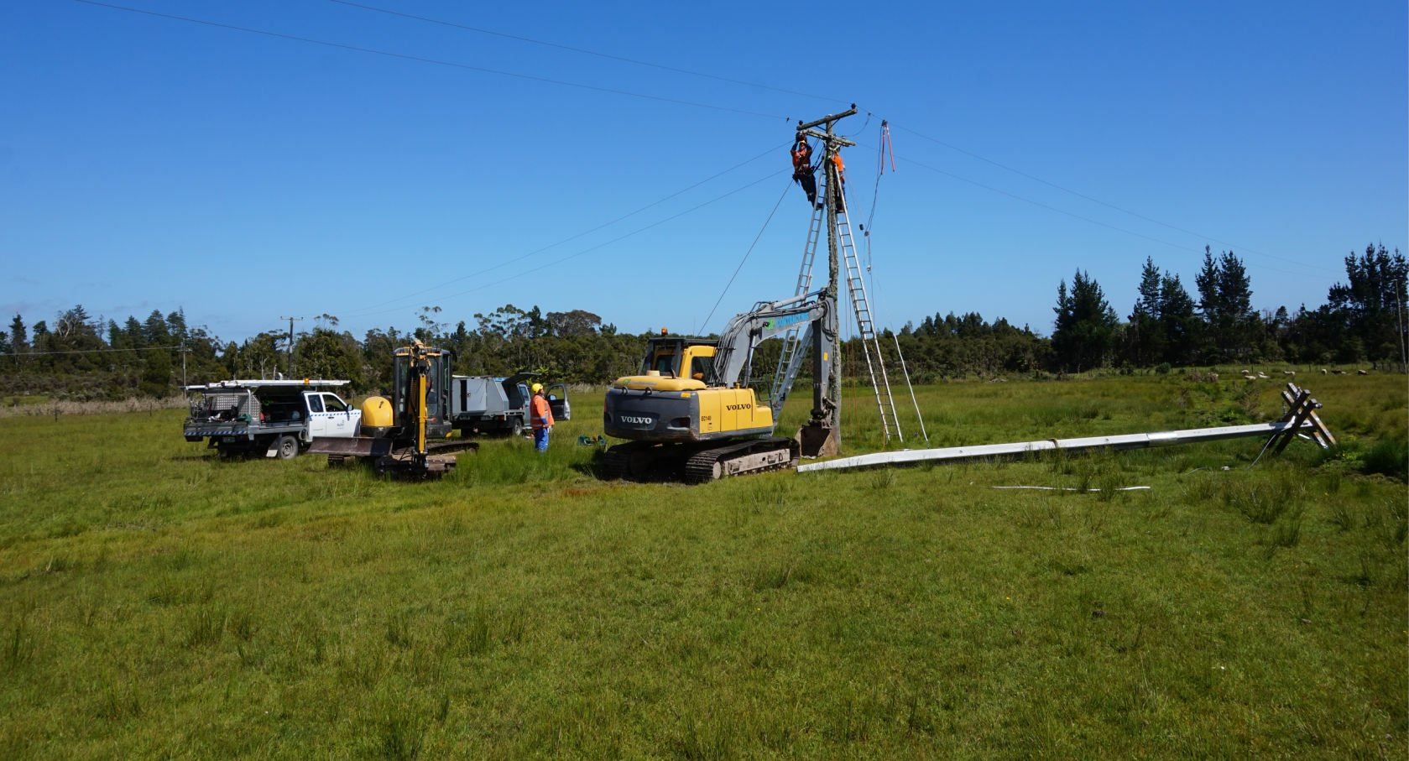
About Buller Electricity
Buller Electricity Limited (BEL) is the local electricity distribution company supplying 4,900 consumers located on the northern West Coast of the South Island. The BEL distribution area extends from Meybille Bay in the south (5km north of Punakaiki), to Karamea in the north.

Slide 3
Operate at voltages as high as 33,000 volts.
Use an "air gap" to prevent electricity from discharging to the ground.
Can create electrical arcs to nearby conductive objects.
Conductive materials such as the human body, tools, vehicles, and even trees can carry electricity.
Higher voltages allow electricity to jump greater distances.
Exposure to high-voltage current can result in severe burns and cardiac arrest.
Keeping safe around electricity

Slide 4
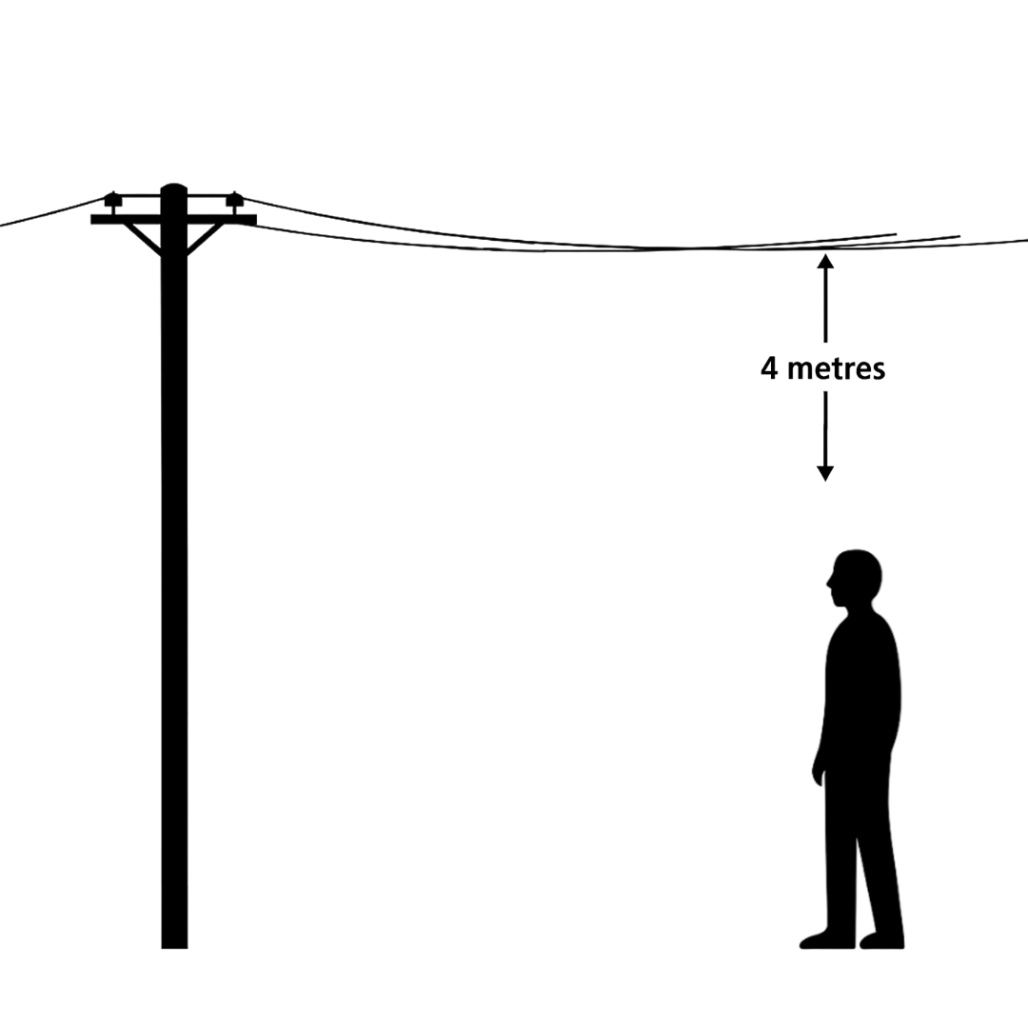
Keep away from live lines
People and machinery must stay at least 4 metres away from overhead power lines.
This distance is measured from the lines themselves—not the pole.
To work within this zone, you must first obtain consent from Buller Electricity.

Slide 5
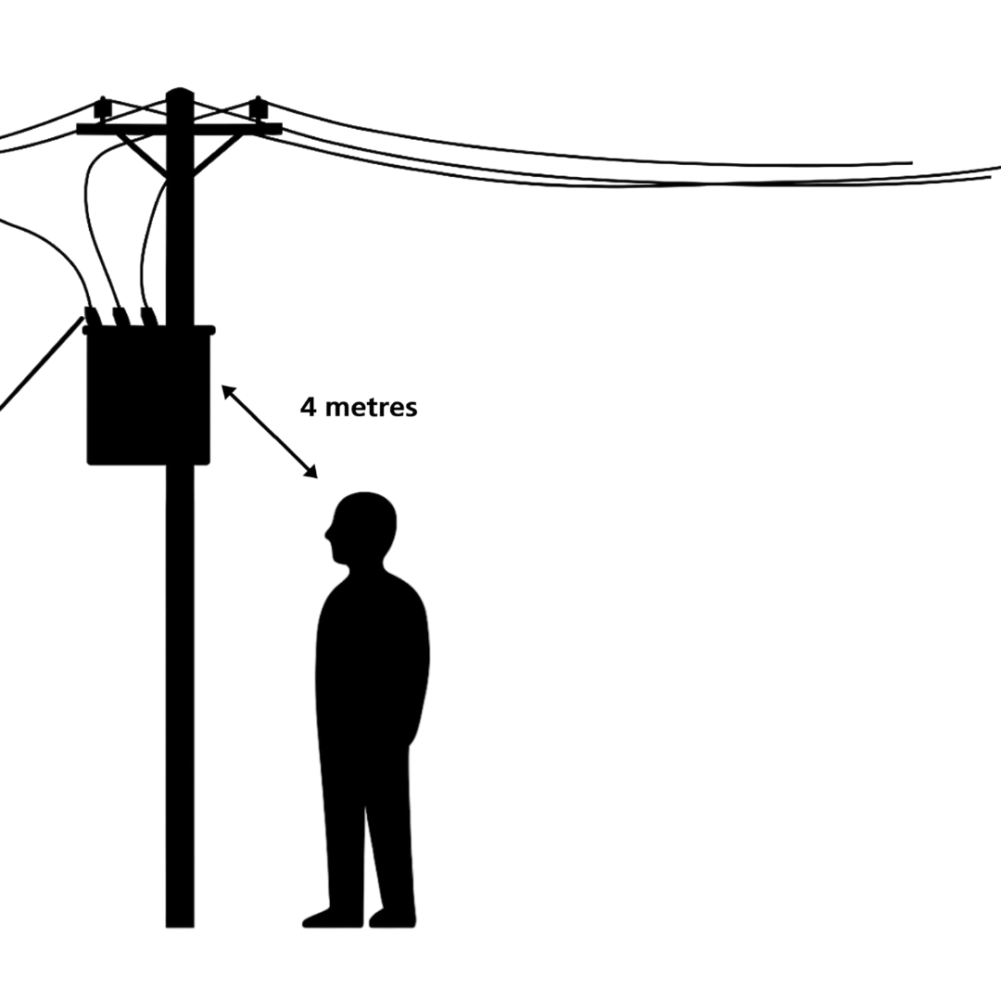
Be aware of pole-top equipment
This rule also applies to live equipment mounted on poles, such as switches and transformers.
To work closer than 4 metres, you must first get consent from Buller Electricity.

Slide 6
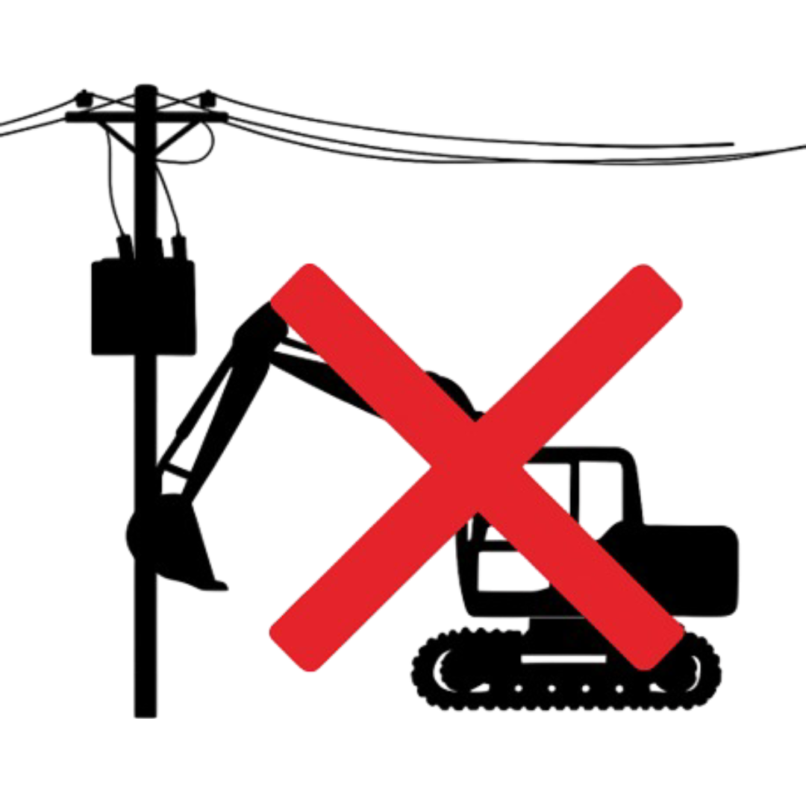
Keep machines away from live lines
Getting too close to power lines - even without direct contact - can cause electricity to arc and travel through a vehicle, rushing into the ground.
This can seriously damage the vehicle and pose a significant risk to anyone nearby.

Slide 7
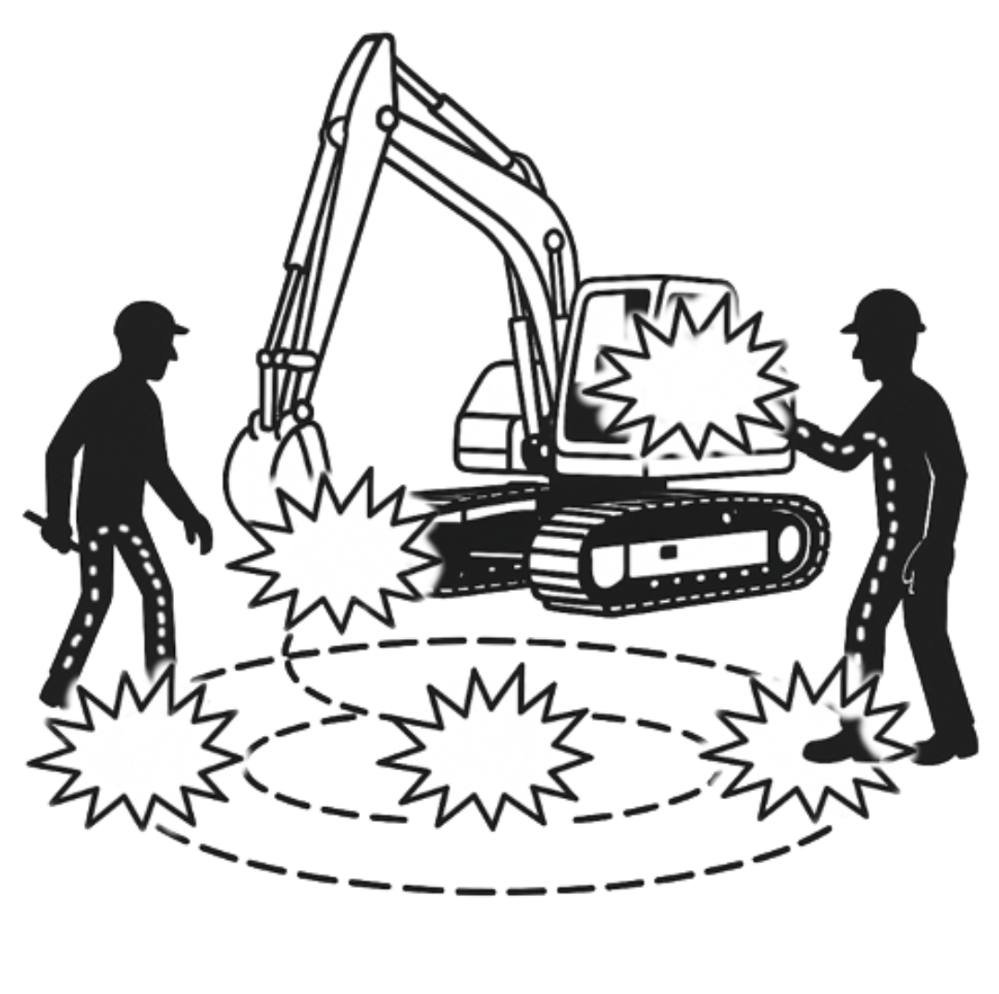
Step and touch potential
Electricity can flow down through the machine and liven the surrounding ground, creating a hazardous area that can seriously harm anyone nearby.
Electrical current can flow through the digger’s chassis and into anyone touching it, leading to electric shock and severe burns.
Electric current can enter through one foot and exit through the other, resulting in electric shock and serious burns.
Earth Potential Rise (voltage in the ground)

Slide 8
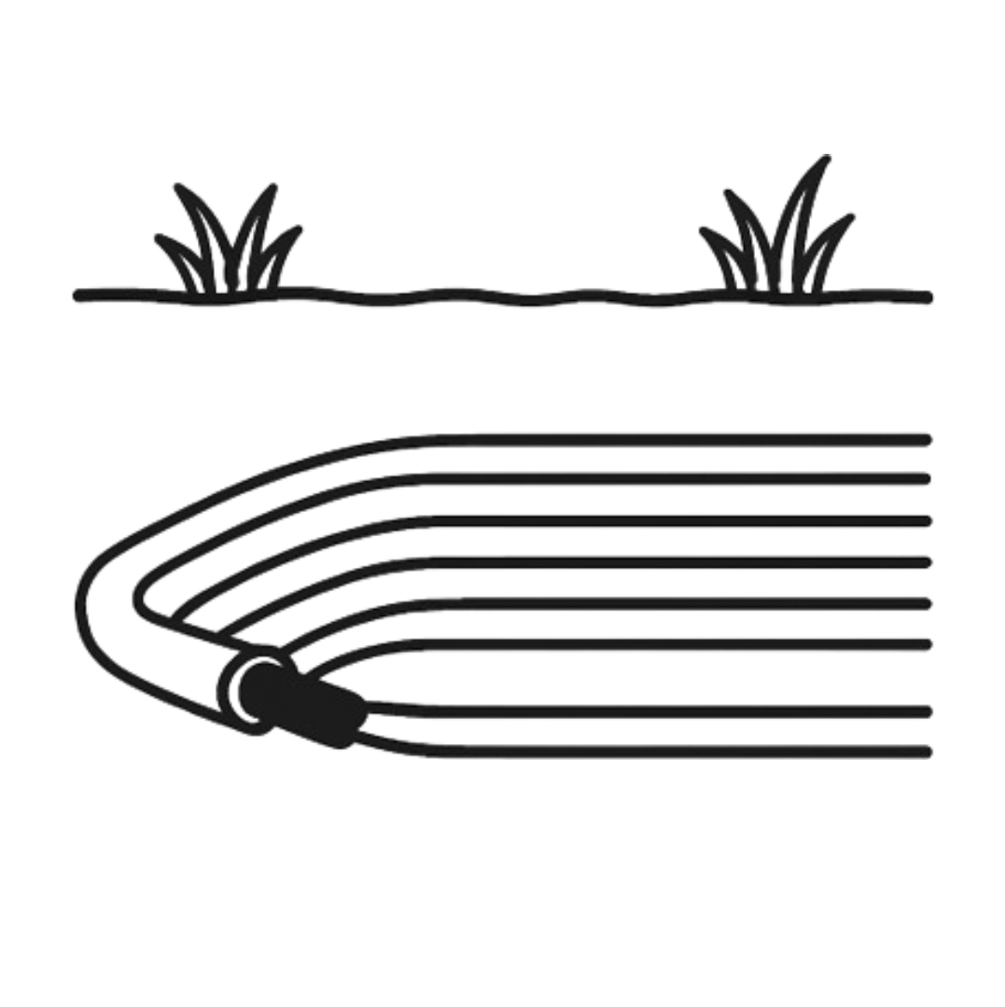
Beware of underground cables
Underground cables carry voltages ranging from 230 volts to 33,000 volts.
They are commonly found along roadsides and in residential areas.
These cables can be easily damaged by tools such as excavators or shovels.
Damaging the insulation can trigger an electrical arc flash - resulting in a dangerous explosion.

Slide 9
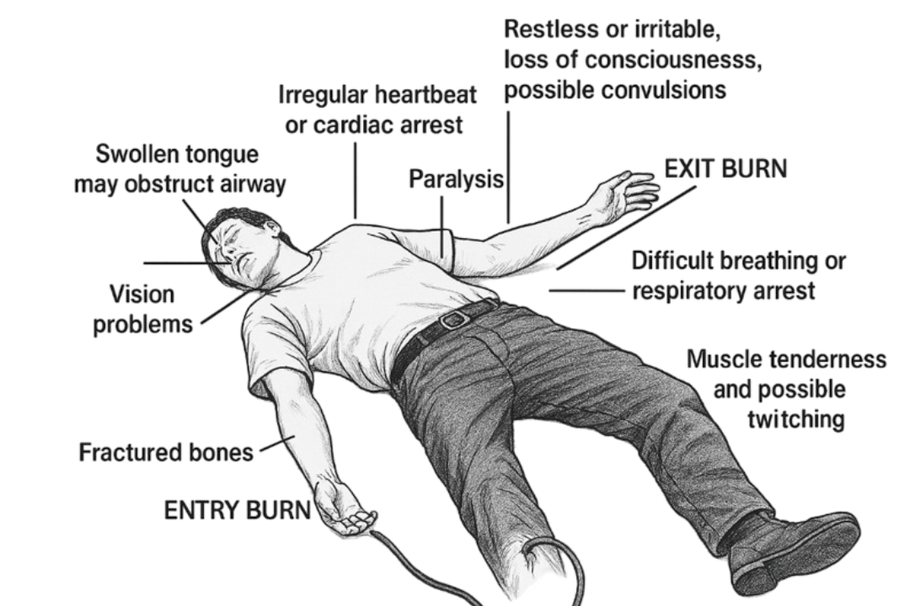
Effects of electricity on the human body
Electricity can cause serious harm

Slide 10
Managing work near powerlines
Certain tasks involve people or machinery operating within four (4) metres of power lines. It is legally mandatory to obtain a Close Approach Consent from BEL.
Close Approach Consent
In some cases, a reduced Minimum Approach Distance (MAD) may be allowed based on the nature of the work.
BEL will provide specific restrictions and special conditions to ensure the safety of workers, the public, and the network.

Slide 11
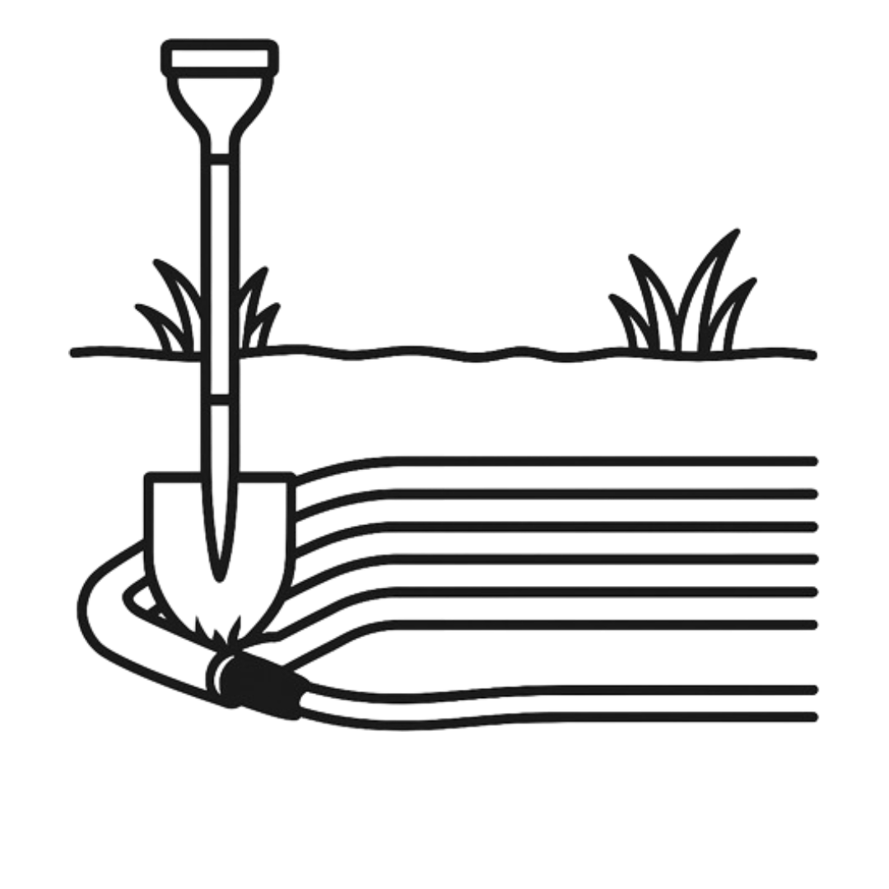
Digging and underground cables
BEL requires you to have a Close Approach Consent when digging within four metres of underground cables. It is your responsibility to identify the cables and avoid causing damage.
Locate cables before starting any digging. Contact BEL for assistance.
Confirm the exact location and depth of cables by pot-holing or hydro vacuuming before using mechanical excavation within 2 metres of the cables.
Never rely solely on plans, plans can be inaccurate or incomplete!

Slide 12
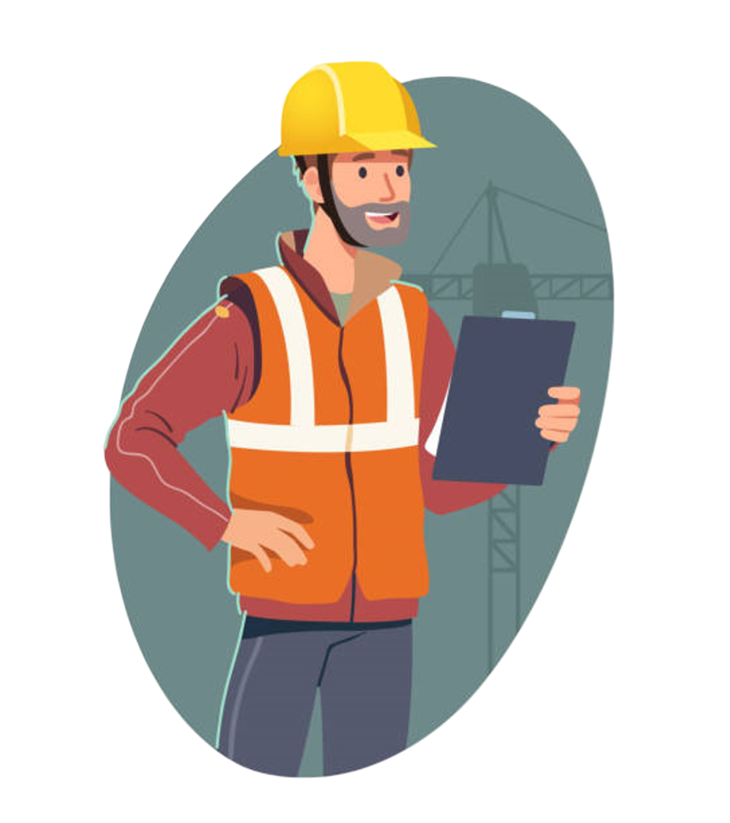
Receiving a Close Approach Consent
The Supervisor on site must receive and retain the Close Approach Consent.
The Supervisor must:
Notify BEL before any work begins.
Ensure all work is carried out in full compliance with the Consent conditions.
Be available and contactable by BEL at all times during the work.
Stay on site whenever personnel or machinery are within four (4) metres of power lines.
Make sure all team members understand the electrical hazards involved.
Be competent—this includes completing the required training material.
Notify BEL and sign out once the work is complete.

Slide 13
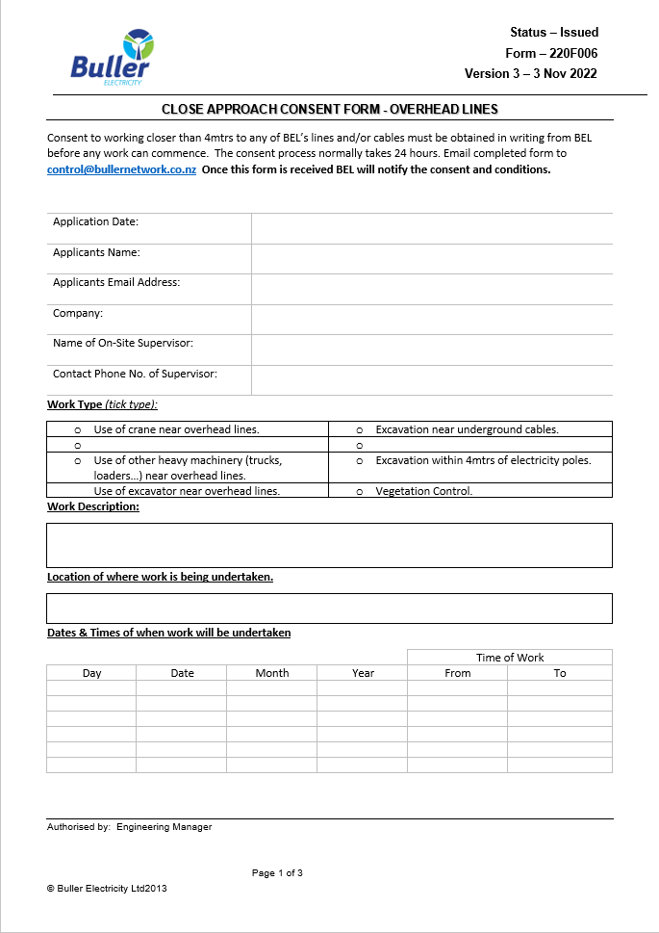
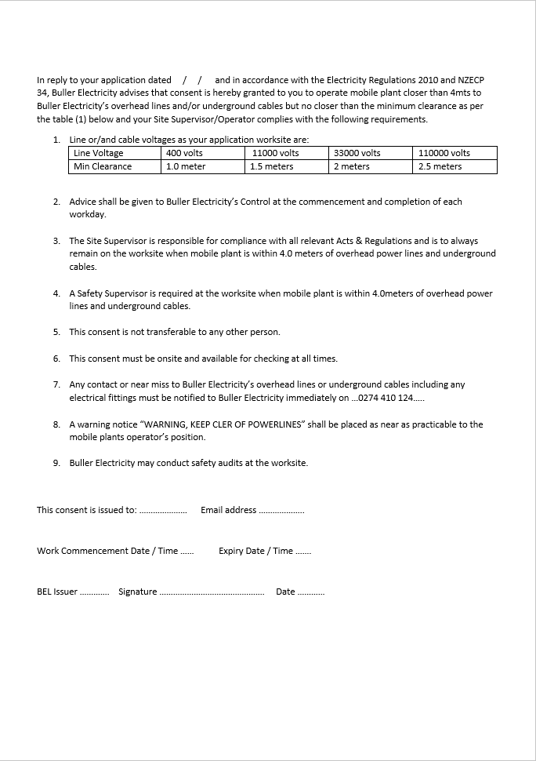
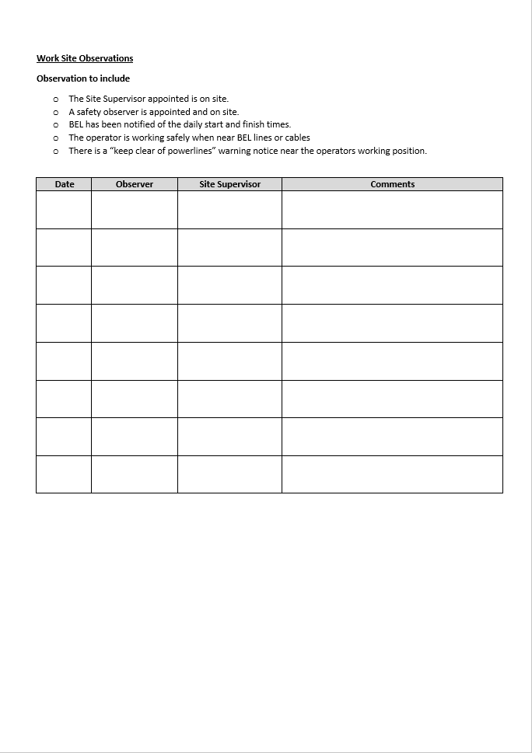
Example of Close Approach document

Slide 14
Complying with your consent
Strictly follow the reduced approach distance specified in your consent - this distance is in place for your safety.
Only competent and qualified workers are permitted to work within the reduced distance.
A copy of the Close Approach Consent must be kept on site during all work.
BEL may stop the work at any time.
Do not attach warning signs, flags, or any other materials to power poles.
If the work cannot be completed safely, it must be stopped immediately.
The consent is non-transferable and applies only to the approved person or organisation.
The consent holder is responsible for any damage caused to BEL’s network during the work.

Slide 15
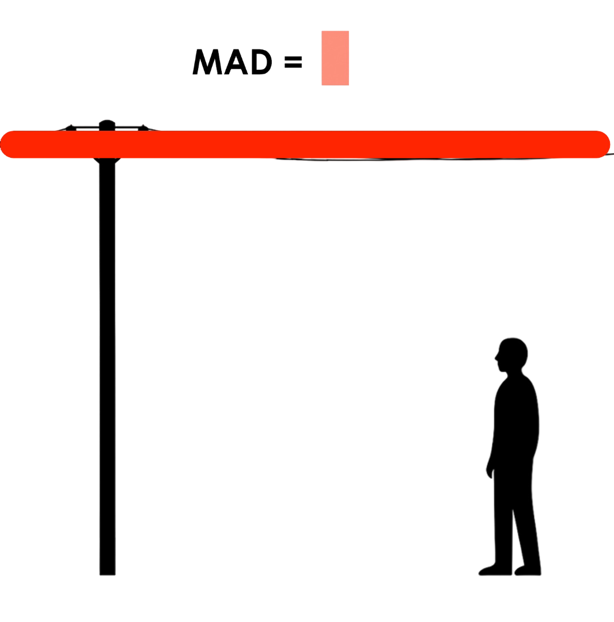

Working at reduced Minimum Approach Distance (MAD)
Think of the MAD as a NO GO ZONE around bare live equipment.
Example shows a low voltage line
Higher voltages = larger MAD

Slide 16
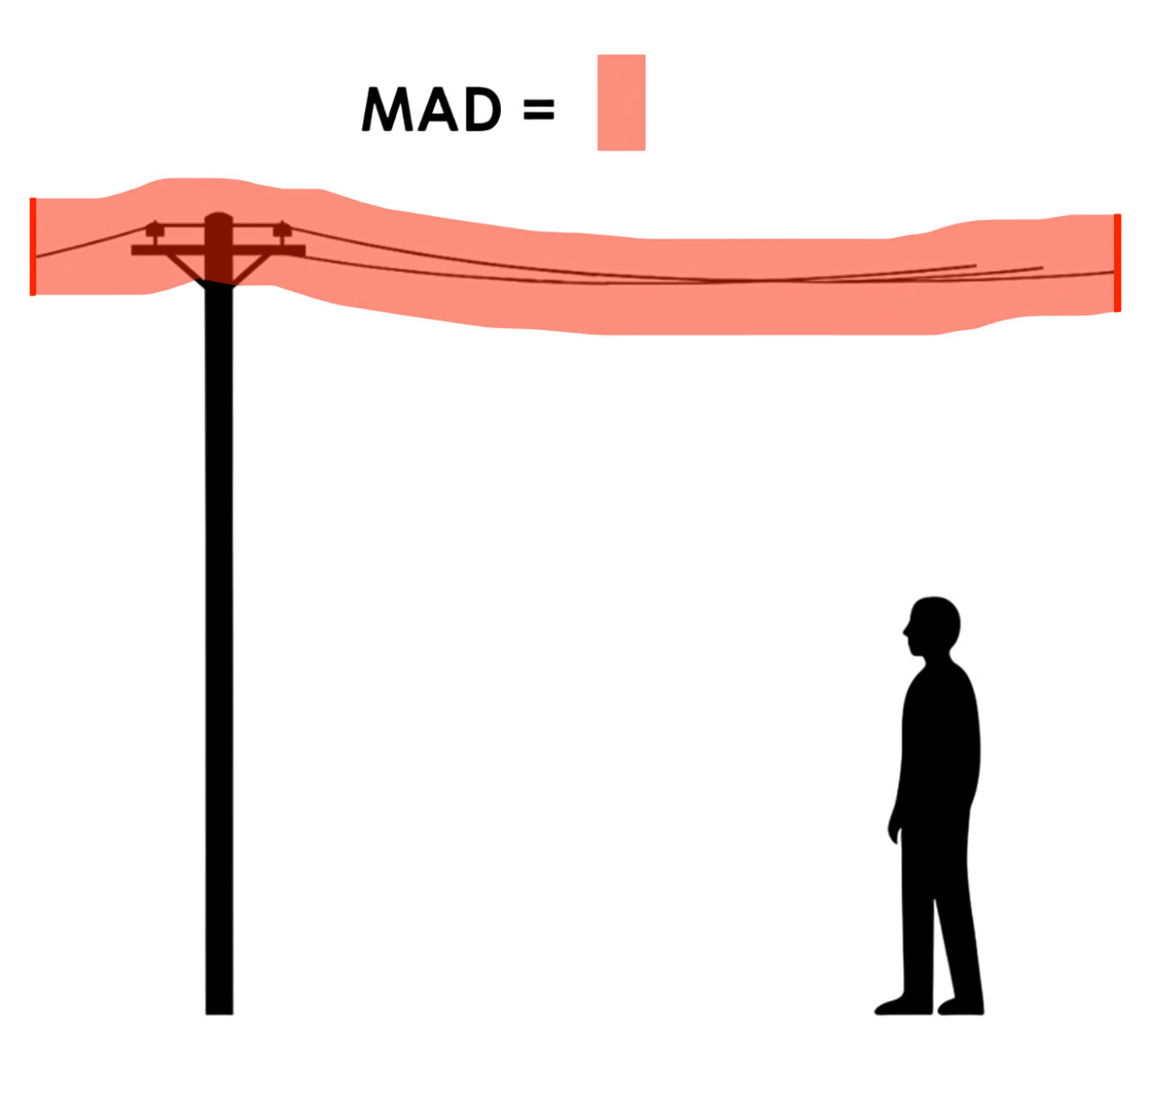





Working at reduced Minimum Approach Distances (MAD)
These distances apply to all parts of a person’s body and anything they are touching or carrying. Do not enter the reduced approach distance under any circumstances.
Examples:
•Tools: pole-saws, measuring tapes
•Vehicles, ladders
•Scaffolding and scaffold poles
•Equipment: ropes, hard hats
•Tree branches
•Roofing iron, fencing wire

Slide 17
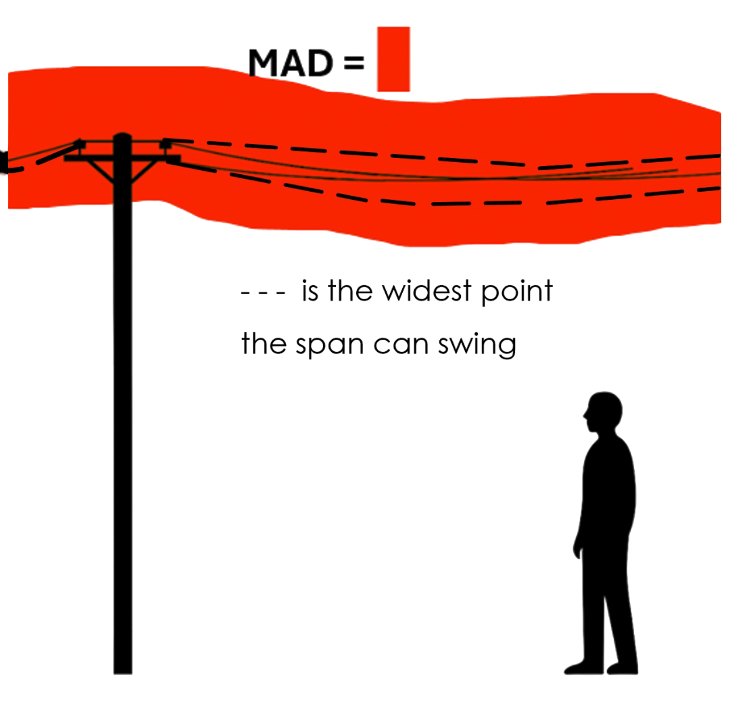
Working at reduced Minimum Approach Distances (MAD)
In windy conditions, the MAD is measured from the widest point the span can swing.

Slide 18
Managing the electrical hazards
Before approaching power lines on the worksite, you MUST:
Identify all electrical hazards.
Assess the risk of coming too close to those hazards.
Implement controls to ensure your team, tools, and vehicles remain outside the MAD.
These three steps will be covered in detail on the following pages.
Note: It is the employer’s responsibility to ensure all personnel are competent for the task, including understanding the risks associated with electrical hazards.

Slide 19
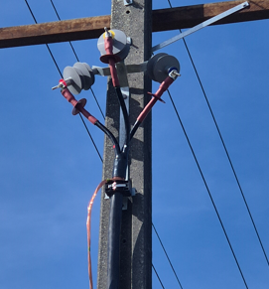
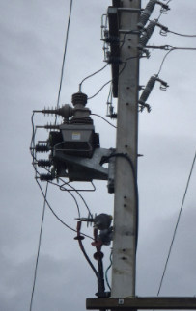
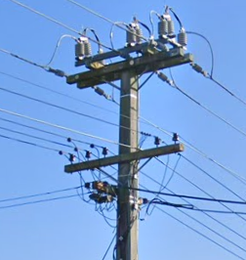
To work near live lines (conductors), you must maintain the minimum safe distance from any live parts.
Overhead lines are not the only live components - other parts may also carry voltage and pose a risk.
1. Identify all electrical hazards

Slide 20
2. Assess the risk of breaching MAD
The risk of accidentally coming too close to live parts must be carefully managed. The type of work being done directly affects the likelihood of breaching the Minimum Approach Distance (MAD).
Some tasks carry a higher risk and require additional precautions.
Example – Roofer working near power lines:
Handling roofing iron near power lines increases the risk of breaching the MAD, especially in windy conditions.
Roofing iron can be difficult to control and may be blown into live lines, creating a serious hazard.

Slide 21
If there is a risk that the Minimum Approach Distance (MAD) may be breached, additional control measures must be taken. These may include:
Increasing your distance from the line
Installing warning signs and/or bunting flags
Appointing a safety observer to warn workers when proximity becomes unsafe
Engaging electrical specialists
Using specialised machinery designed for close approach work
Arranging for the line to be isolated and earthed by BEL
Taking other actions appropriate to the specific situation
3. Controlling the risk

Slide 22
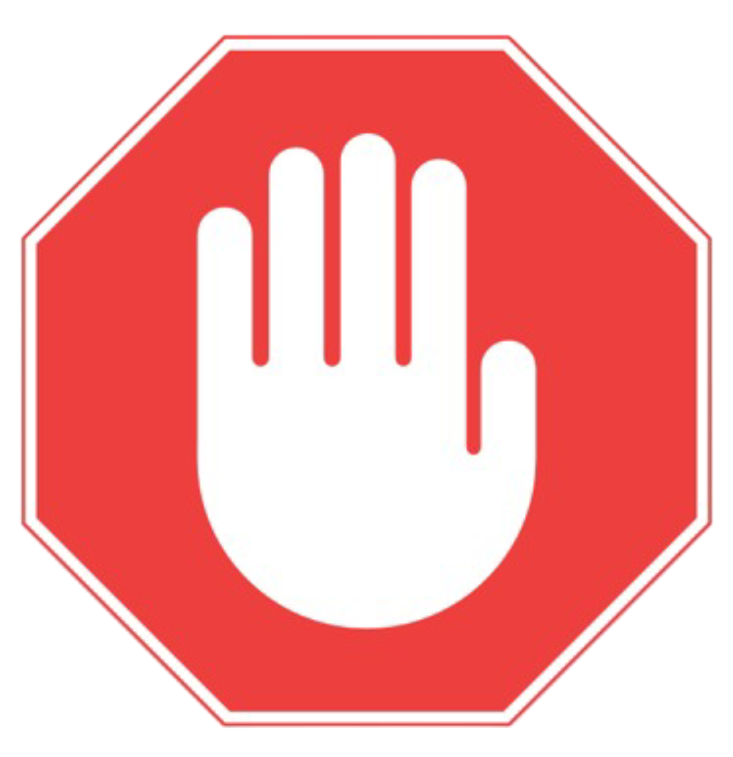
Controlling the risk
If it’s not safe don’t do it!

Slide 23
Incident and accident reporting
All accidental contact with overhead lines, underground cables, or any damage to network assets—no matter how minor—must be reported immediately.
Even if lines or cables appear undamaged, electrical protection systems may have activated elsewhere on the network, potentially disconnecting customers.
Stop work immediately
Call BEL to report incident
BEL will immediately take action to ensure the safety of people and the network
Treat all lines as LIVE
- Give your name
- Job name and location
- Details of what happened

Slide 24
Thank you for your attention

